Slide 1

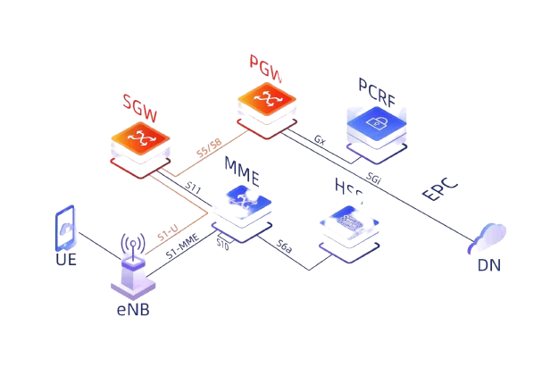
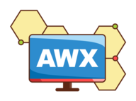
Core Network Automation
Novembre 2023
Octobre 2024
Stephane Gratias

Slide 2












CONTEXT
OPERATOR
USER
Repetitive and long tasks on infrastructure with a relevant business value
Increase automatic setup to decrease human intervention on infrastructure
Improve the autonomy of technical teams with a reduction of infrastructure
Easy interface to configure complexe setup
All information in one place for business and technical teams
Security, notification, acces filtering and should plug with actual tools
Software with a huge active community can manage many IT systems, from IoT and network devices to Linux and Windows Servers

Slide 3
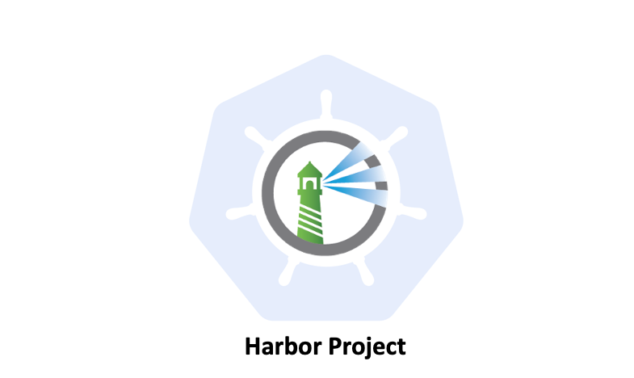


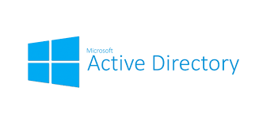

TECHNICAL ENVIRONMENT
Pull collections
Centralized authentication
Pull code & image
Pull tickets
Filtering Access
USER
INFRASTRUCTURE
Notifications
OPERATOR

Slide 4
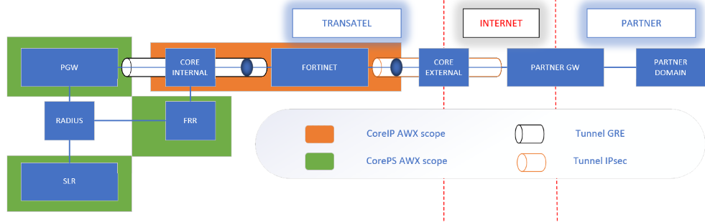
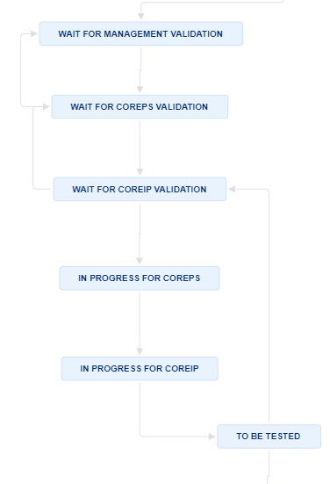
SINGLE IP
Core IP & PS scope with easy to fill Jira ticket form
90% of the SingleIP scope has been automated
Multiple waitting step to be sure the request is clear (client and internal side)
Production deployment around an hour and decommissioning easier than deployment
Leave the more advanced testing and setup to the technical teams

Slide 5
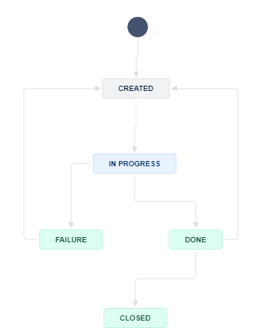
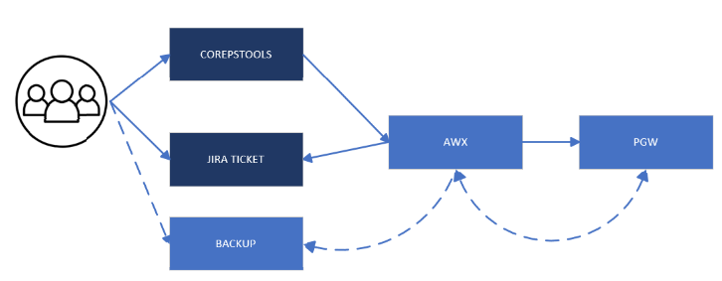
TRACES
User which will use jira ticket are limited to 10 traces running (in progress ticket state), no limitation for corepstools
Output traces are fetch from the PGW to Backup server then removed
End user have to removed by himself traces on backup server
Easy to reproduce on another technical device

Slide 6
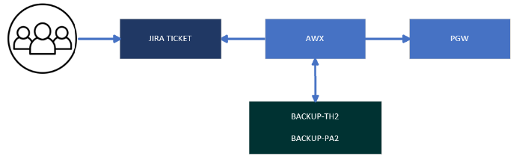
LEGAL REQUISITION
AWX workflow will return the right PGW of the Public IP then find log on Backup servers with PGW name and timestamp to send it directly in the ticket
The whole process for legal requision (from email receving to logs show) are now automated

Slide 7
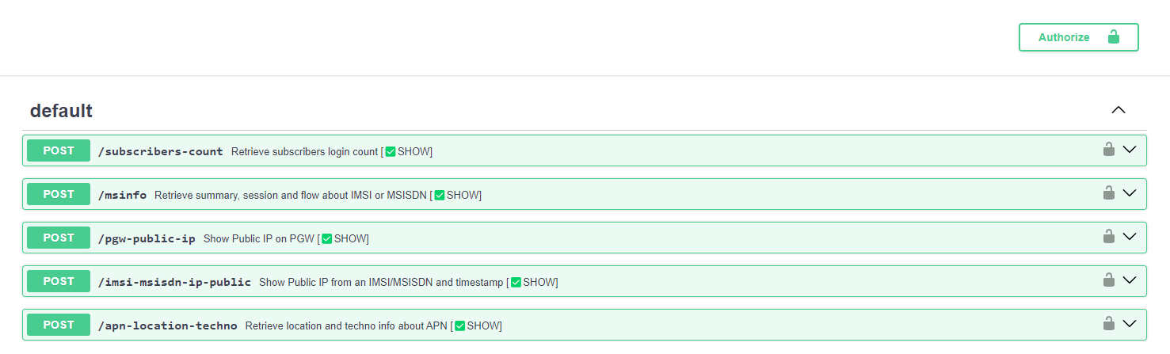
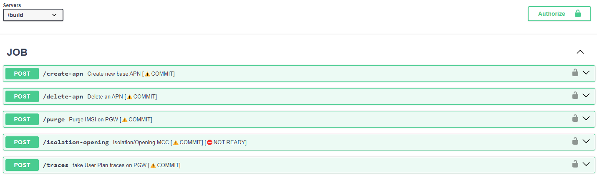
DEMO COREPSTOOLS
https://corepstools.coreps.priv.transatel.net/
https://corepstools.coreps.priv.transatel.net/build/docs

